Slide 1

SpoTaufy
Tanner, Ethan, Evin, & Phoebe

Slide 2

AGENDA
20XX
20XX
20XX
20XX
20XX
Background
Dataset
Linear Regression
Classification
Conclusions
A quick introduction to the music industry, and why this project pertains to you
A look at our dataset and our variables
Fitting our dataset into a linear regression model, and challenges we faced along the way
Using several types of classification in order to improve our model’s predictive power
Takeaways, and additional value we could provide in the future.

Slide 3
BACKGROUND

Slide 4
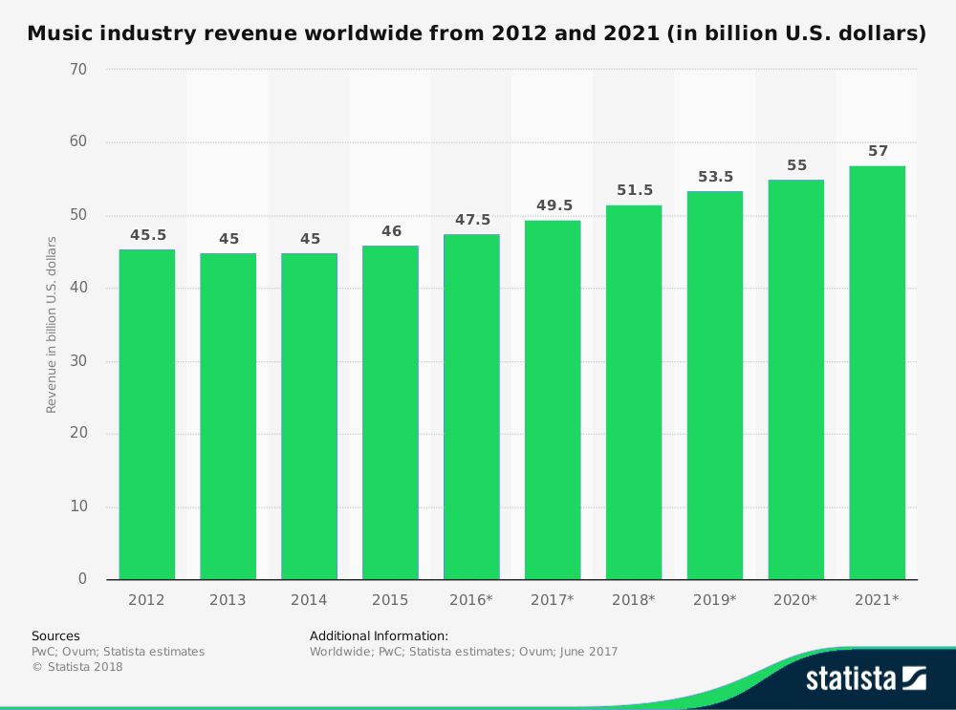
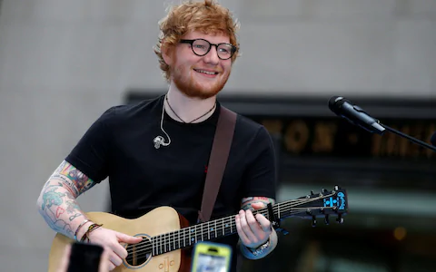
Music Industry Snapshot
Notes:
Streaming Revenue is huge: grew by over 40% in 2017 → 176 million users
Fun fact: ed sheeran was last year’s most streamed artist
But I hear you saying, Phoebe, how can I possibly get in on this growth if I don’t have any musical talent?

Slide 5
Welcome to music production!
Notes:
Narrative: talk about the industry

Slide 6
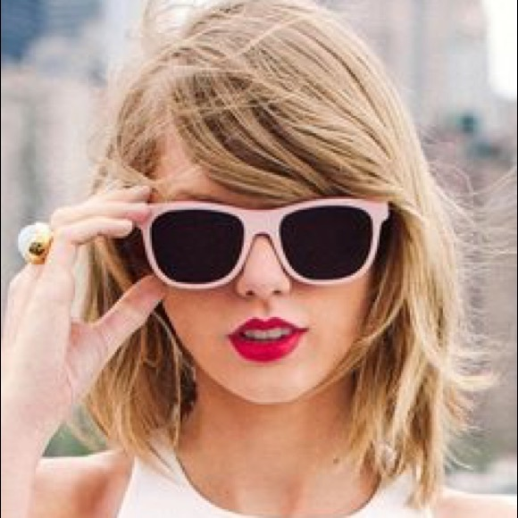
Background
The music industry is one of the most glamorous industries in the US
If your label is extremely successful, it could also be in one of the most lucrative industries
The “big 3” labels make $14 Million a day from streaming songs alone
Pattern recognition makes the industry ripe for machine learning advances
Notes:
three label groups now collectively making $14.2m a day from streaming (Universal Music Group, Warner Music Group, Sony Music)

Slide 7

Our Focus, and Spotify’s Role
Problem that faces producers: in 2018, due to advances in technology and rise of streaming...
Millions of songs are released each year
What can we solve: Using machine learning models, you can predict common traits among current hits in order to more accurately select future hits.

Slide 8
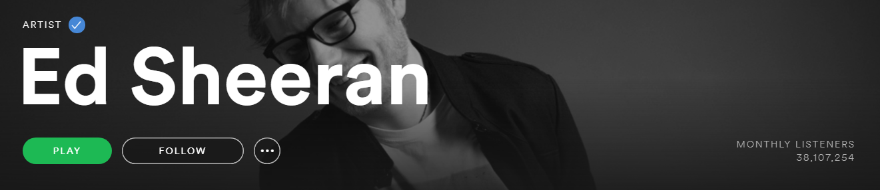
What will our model try to predict?
Track popularity from songs on Spotify.
Why?
Predicting popularity means predicting revenue!
Notes:
On average, whoever owns the rights to the song(music artists/labels) make $.007 dollars (aka a seventh of a cent per play) This doesn’t sound like a huge amount but going back to Ed Sheeran, his total of monthly listeners is around 38 million. If each of these listeners only listens to one song a month, $3.2 million in revenue in a year if he maintained at least that current amount of monthly listeners.

Slide 9
DATASET

Slide 10
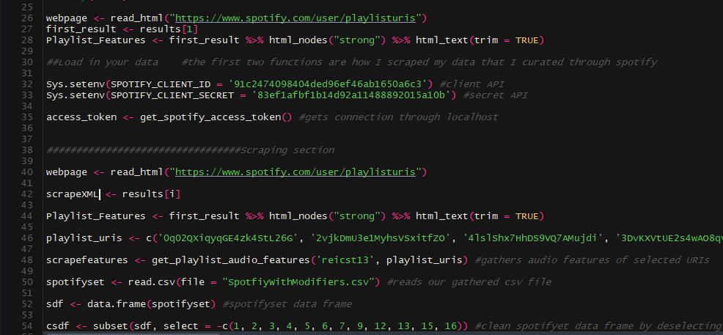
Obtaining the Data

Slide 11
Variables
Valence Acousticness
Danceability Liveness
Energy Tempo
Numeric_key Duration_s
Loudness Time Signature
Speechiness
Binary_mode

Slide 12
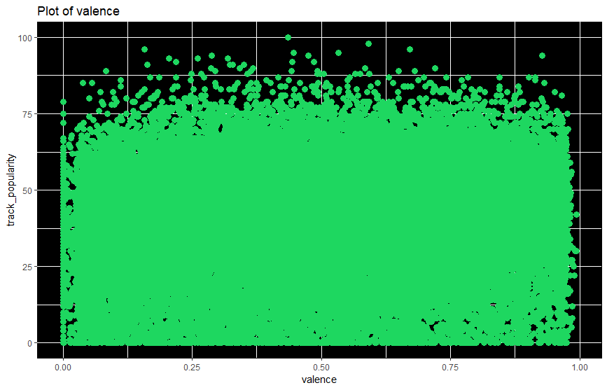
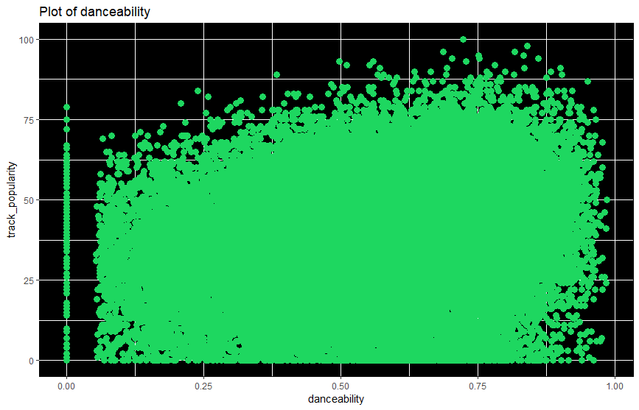
Valence Danceability

Slide 13
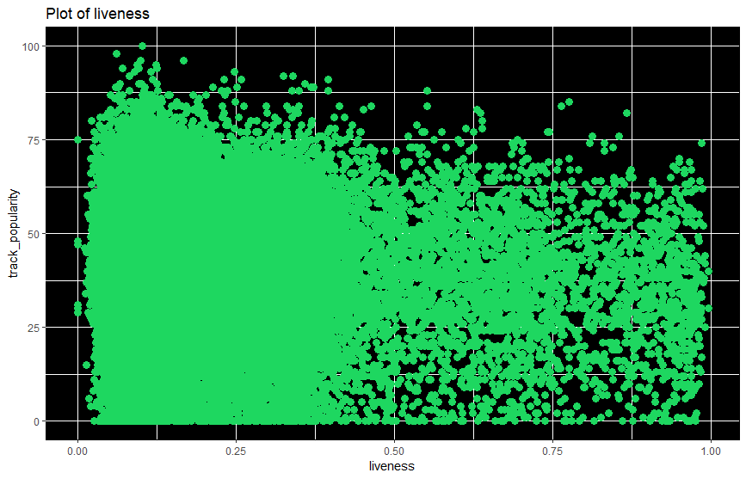
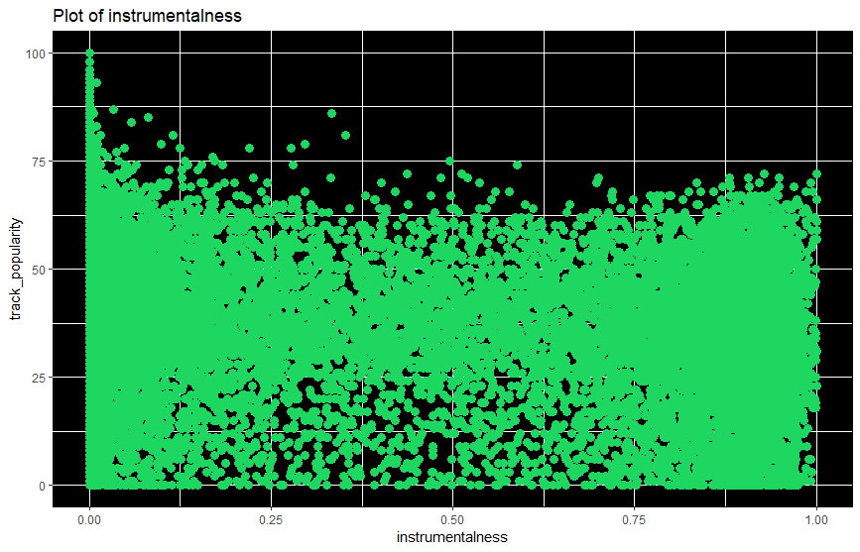
Liveness Instrumentalness

Slide 14
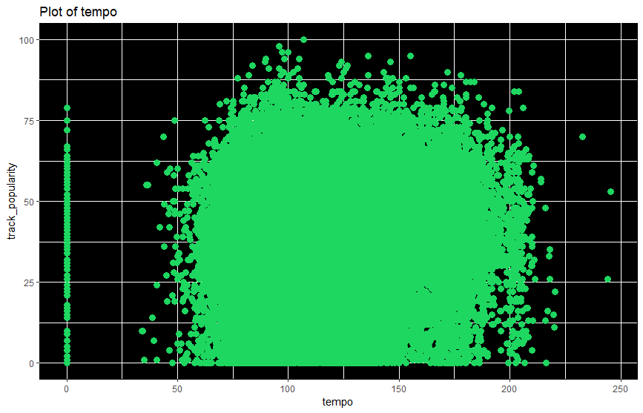
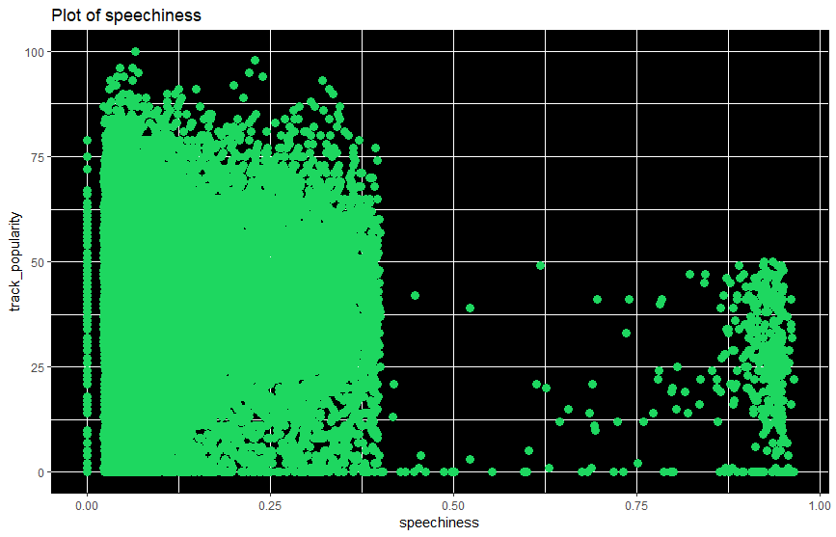
Tempo Speechiness

Slide 15
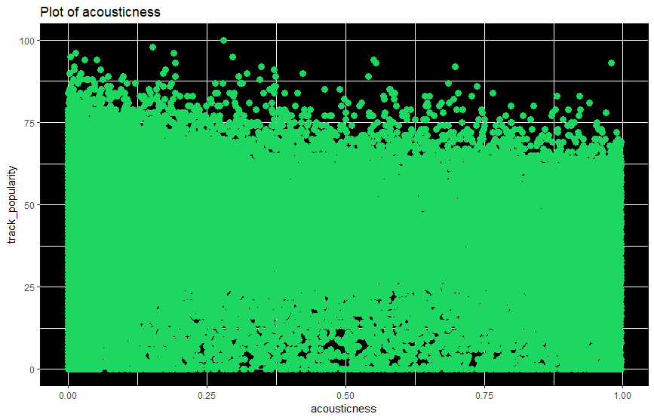
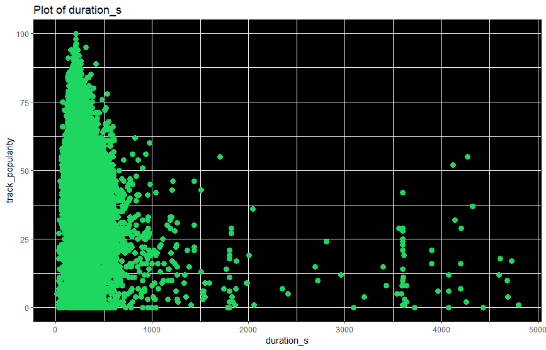
Acousticness Duration_s

Slide 16
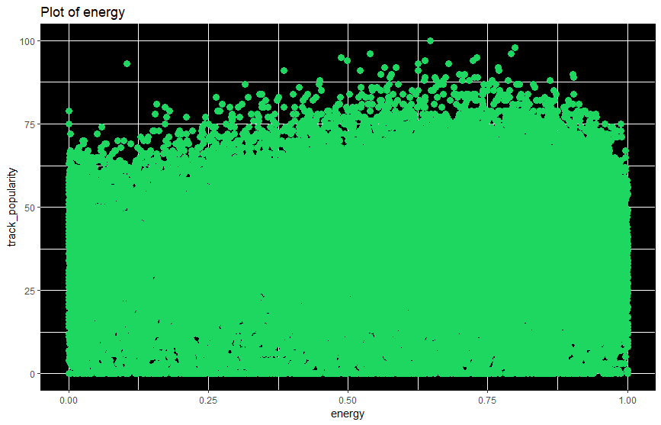
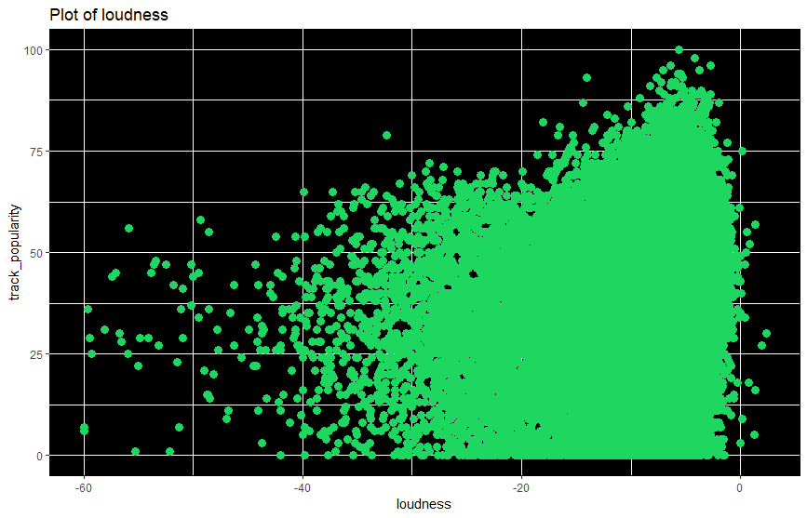
Energy Loudness

Slide 17
INITIAL REGRESSION MODEL

Slide 18
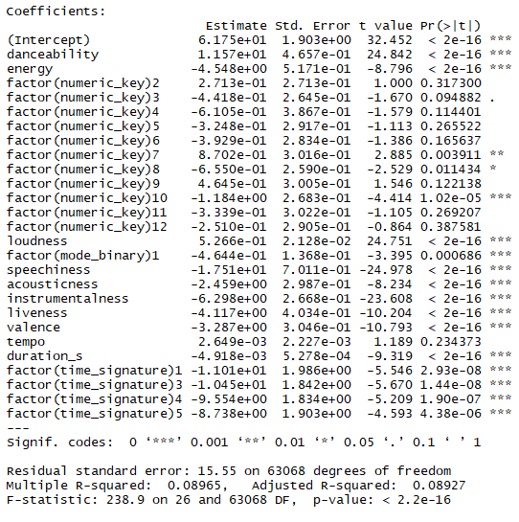
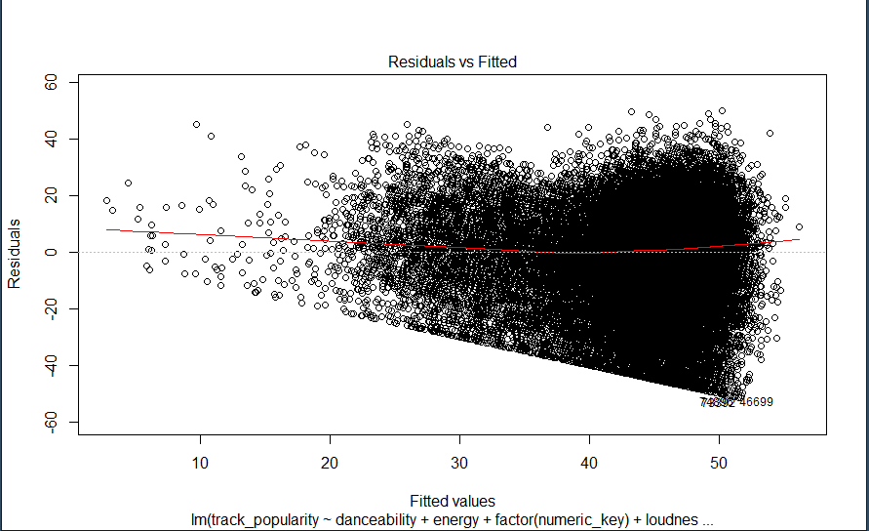
We found that...
Notes:
For our initial model, we plotted a linear regression, though the fit was rather poor, with an adjusted R-squared of roughly 0.09, we did find that nearly every variable except for some keys and tempo were significant.

Slide 19
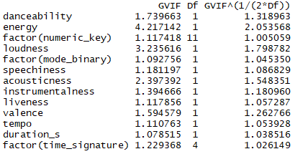
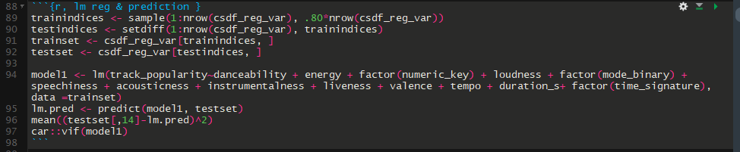
Searching for sources of errors
Notes:
We assumed part of this bias initially could possibly be due to multicollinearity between our variables, yet in our VIF test we were unable to remove any variables other than non-significant ones from the first regression, and suggested instead that our model may be suffering from omitted variable bias.

Slide 20
REVISED MODEL
Notes:
These steps led us to the revised version of our linear regression model

Slide 21
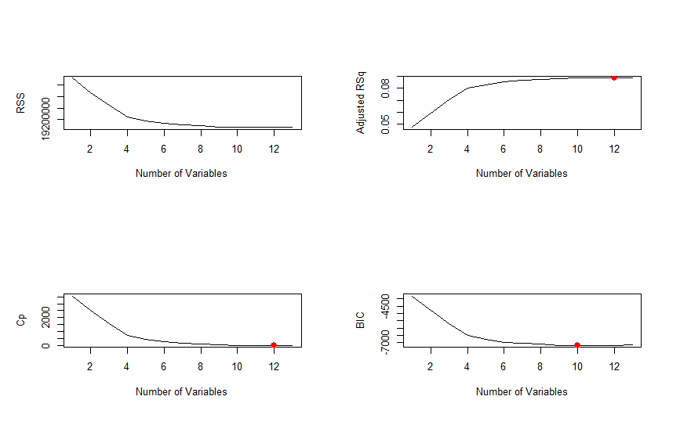
Best Subset Selection
Notes:
Using both the forward and backwards methods of subset selection, we attempted to find the best number of variables to include in our revised model. This, unfortunately, did not yield us any particularly useful results, as most models indicated that we ought to be using the majority of variables that we have.

Slide 22
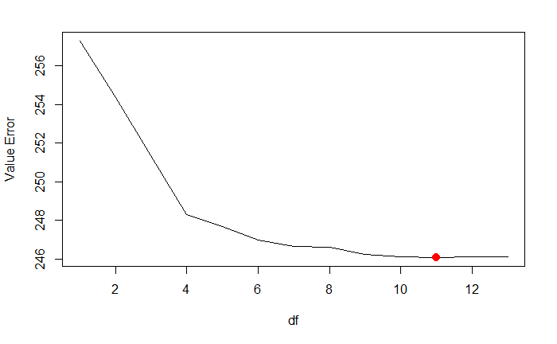
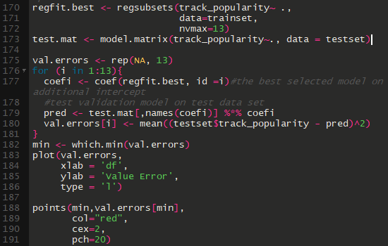
Attempting to reduce error terms
Notes:
We also attempted to see if we could reduce the error terms by changing the number of variables selected, yet we further found that our model was not substantially improved from before.

Slide 23
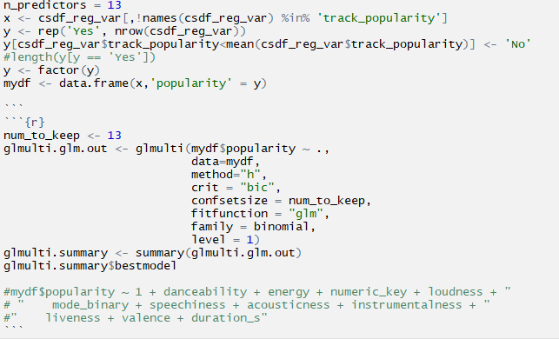
BIC Classification… and 8500 iterations!
Notes:
Given the information above, we used the terms suggested by the BIC error rate in order to generate a best fit new regression model, and tested this on 8500 iterations of the model.
I dont even know where my phone is. It’s better that I don’t get distracted.
The skinny of things is that I’ve got the speaker notes to give you about 1 sentence to say per slide, which will speed things up and be concise. I’m about to work on classification, but please feel free to make any changes.
Is that a good compromise?indeed I will briefly talk about bic classification just to show that the best classification model gives use all the variables except tempo which we will be using in the rest of our classification model such as qda and lda.

Slide 24

Ultimately we decided against linear regression.
Though being able to directly predict the popularity of a song based off of its characteristics would indeed be useful, the model unfortunately did not appear to be a great fit.
We highly suspect that many of the predictors are in fact quadratic terms, which would drastically change our regression.
Notes:
For the reasons above, while we ultimately could not feel confident suggesting a linear model, we were inspired to try to create a classification model instead.

Slide 25
CLASSIFICATION

Slide 26
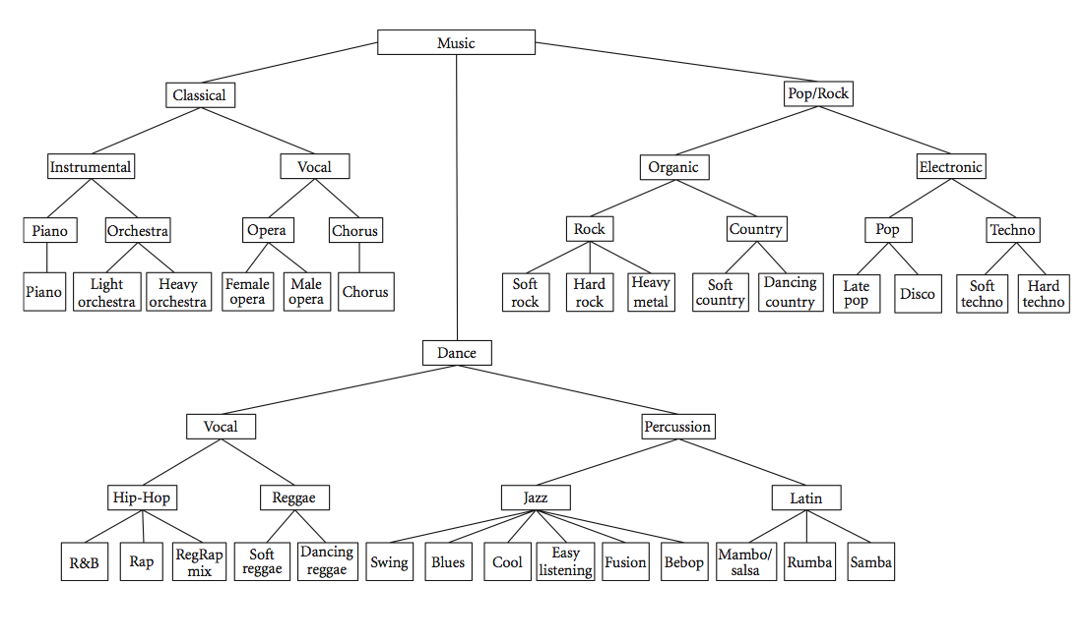
Classification Justification
As music in the same genre tends to follow particular patterns, we thought classification may be a better regression model for prediction
We created a binary variable for popularity in order to predict if a song will score above the median popularity level.
Notes:
The slide number is off for some reason,
yeah majorly

Slide 27
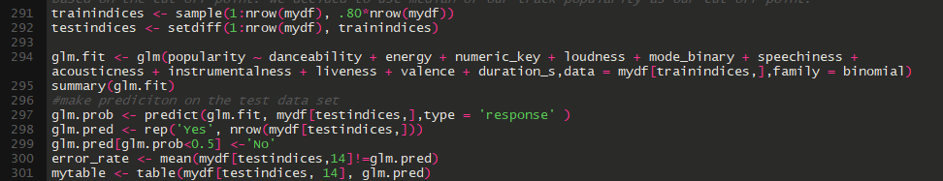
In order to find our best classification model:
GLM
LDA
Notes:
In order to find the best classification model, we tested out a general logistic model, an lda model...

Slide 28
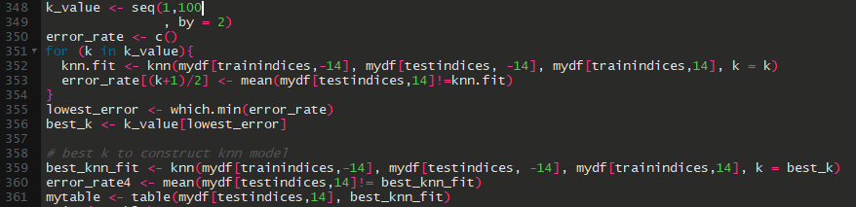
Classification continued
QDA
KNN
Notes:
A QDA Model, and a KNN Model

Slide 29
Comparison of Errors
 | GLM | LDA | QDA | KNN (k =5)
Overall Error Rate | 0.405 | 0.406 | 0.409 | 0.351
Type 1 Error | 0.634 | 0.655 | 0.701 | 0.453
Type 2 Error | 0.205 | 0.186 | 0.152 | 0.261
Power | 0.795 | 0.814 | 0.848 | 0.738
Precision | 0.588 | 0.585 | 0.579 | 0.649
Notes:
Here are the associated Error rates, power, and precision terms for each of the models.
The clear winner was KNN, which had the lowest overall error rate.
We further chose this model to minimize the Type 1 error rate, which would be predicting that a song would be popular when it is not.

Slide 30
CONCLUSIONS

Slide 31

Takeaways from our models:
The potential for machine learning in relation to the growing music industry is boundless.
Though our results weren’t outstanding, a model refinement could provide incredible insight.
Notes:
Though the business of predicting the popularity of music is by no means easy, I think it’s safe to say that our model showed that, with enough refinement, it is entirely possible to gain insight into the prediction of popular music through machine learning models.

Slide 32

Trials, tribulations, and more:
Even though KNN had our best error rate, we believe the model suffers from extremely high variance.
Sometimes there’s just no accounting for taste
Popularity spans multiple genres for multiple reasons, perhaps our dataset was too broad?
Genre classification possible

Slide 33

If we had more time …
We would absolutely take more time to refine our data and do things such as:
Exclude non-lyrical tracks
Fit a polynomial regression model
Predict how popular an album gets based of tracks in album
Find a way to weigh in studio success
...and more!

Slide 34

Thank you for your time with:
CONSULTING

Slide 35
Most Popular Song

Slide 36


Slide 37
Least Popular Songs
Notes:
Actually 404 songs with a popularity score of 0

Slide 38


Notes:
Organ cover of

Slide 39
Most Danceable Song that
People Can Recognize

Slide 40


Slide 41
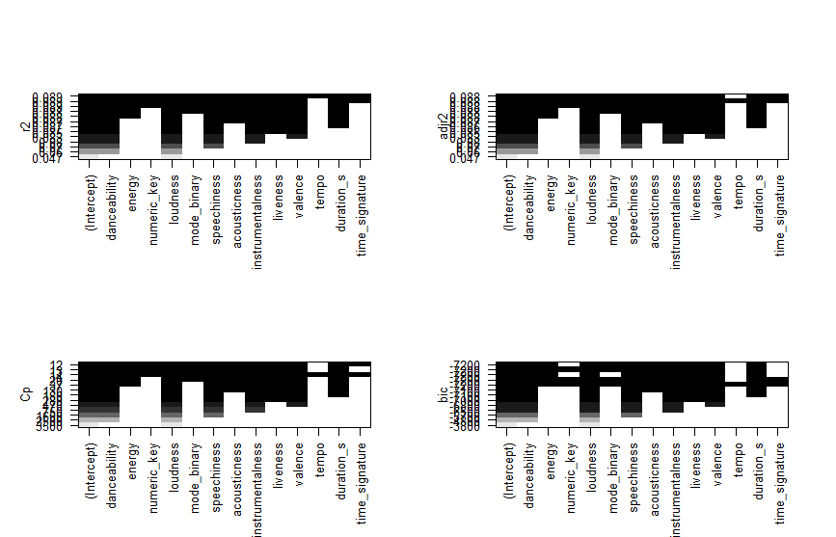
New metrics

